Slide 1
AI Term Project
Spring 2024
Group Members:
Tanushree Arora
Tarasha Bansal
Guided by: Professor Shivanjali Khare

Slide 2

Topic : Fake Voice Detection Model
Do you recall the moment in the movie Terminator where two Terminators were attempting to fool one another by voice-cloning a human? These days, it only takes a few minutes to replicate someone else's voice which is the basis of many scams. This inspired us to build a Fake Voice Detection model using AI & ML techniques to prevent malicious activities.

Slide 3
Project Objectives
Train our AI model to accurately differentiate between bonafide and spoof audio samples.
Detect if a new audio sample is real or fake i.e. if the voice has been altered/ tampered with or not.

Slide 4
Approach
Convolutional Neural Networks - We will use a CNN model on the generated spectograms of each audio and train the model on these images.
Recurrent Neural Networks - Since RNNs can easily handle sequential data like audio, we will use the Long Short Term Memory model (LSTM) and directly use the audio files to train the model.
Comparison - We will compare both these model on their metrics as well as complexity and time taken to train the models.
Weights & Biases - We will be using this tool to track the model’s training.

Slide 5

CAN YOU TELL BETWEEN REAL AND FAKE?
Audio Clip 1
Audio Clip 3
Audio Clip 2
Audio Clip 4

Slide 6
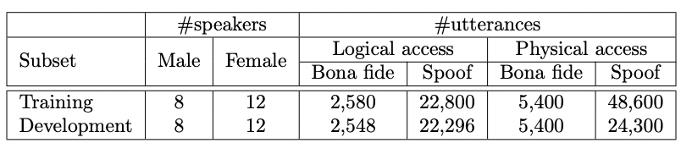
Our Dataset
We adopt the LA Database in the ASVspoof2019 Competition
Multi-Speaker English speech database recorded at the Sampling rate of 96 kHz
With the total of 8 male speakers and 12 female speakers

Slide 7
Overview for CNN
A CNN is a class of deep neural networks, most commonly applied to analyzing visual imagery. CNNs are known for their hierarchical structure which consists of multiple layers that process and transform an input to produce a specific output.
They are usually known for their model development using Image Processing
But in the case of Audio, the audio signals can be converted into images which are known as spectrograms. (Example of spectrogram in the next slide)

Slide 8
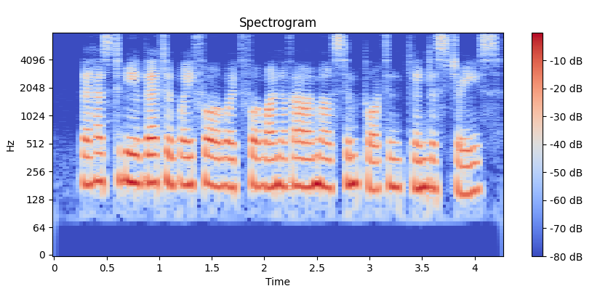

Slide 9
Methodology for CNN
For performing the CNN model on our audio dataset, we converted our audio samples into images in the form of spectrograms (as shown in the previous slide)
From the spectrogram, we split our dataset into training and testing and perform the model fitting
Finally, we plot graphs and calculate the performance metrics

Slide 10
Result Parameters for CNN
Model Accuracy
Model Loss
Confusion Matrix
Performance Metrics

Slide 11
Overview for LSTM
LSTM (Long Short Term Memory) is a recurrent Neural Network (RNN), mostly used in the field of Deep Learning
They have feedback connections which make them capable of processing entire sequences of data.
The capability of LSTM to remember and forget information selectively makes it very effective for speech recognition where the context or sequence of past information is key to understanding the current input.

Slide 12
Feature Extraction
Mel Frequency Cepstral Coefficients (MFCCs) are one of the most popular feature representations used for sound analysis, particularly in speech and audio recognition tasks. MFCCs provide a way to capture the timbral and textural aspects of sound in a form that is well-suited for machine learning models, especially those dealing with audio signals like voice.
For this project, we use a function to extract features from the audio file that loads an audio file, computes the MFCCs, and transposes the result so that each time-step is a row, and each feature (MFCC) is a column, suitable for LSTM processing.

Slide 13
Methodology for LSTM
For performing LSTM on our audio datasets, we extract the features of the audio using MFCC as explained.
Next, we split the data into 75% training data and 25% test data sets.
We use this data to create and fit our model with 10 epoch for best results.
Post this we calculate the metrics to evaluate the model.

Slide 14
Result Parameters for LSTM
Model Accuracy
Model Loss
Confusion Matrix
Performance Metrics

Slide 15
Evaluation of Models
We are evaluating the model based on the following:
Time take to load and process data
Time consumed to train the model
Result parameters shown below
Metrics | CNN Model | LSTM Model
Accuracy | 93.87% | 97.68%
Recall | 58.45% | 87.13%
Precision | 75.70% | 89.25%
F1-score | 65.97% | 88.18%

Slide 16
References
ASVSpoof Research Paper: https://www.asvspoof.org/asvspoof2019/asvspoof2019_evaluation_plan.pdf

